Slide 1


Variational Autoencoder (VAE) and Its variants
Mostafa Tavassolipour
Fall 2024

Slide 2
Autoencoder & Variational autoencoder

Slide 3
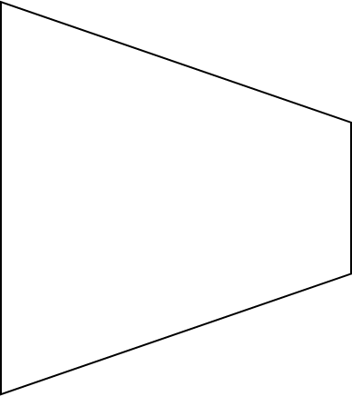
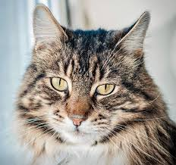
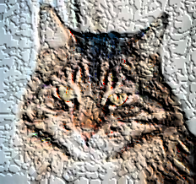
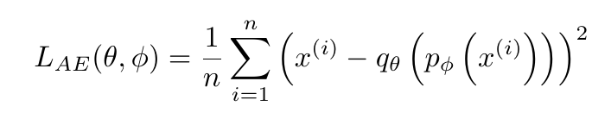
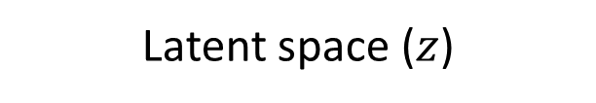
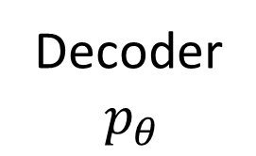
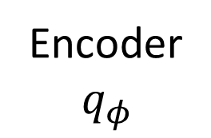
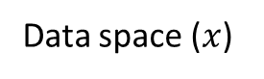
Autoencoder
Low dimensional hidden representation of a sample data
Reconstructed
Input
Encoder
$$q_{φ }$$
Decoder
$$p_{θ}$$
Latent space ($z$)
Reconstruction error MSE loss
Data space ($x$)

Slide 4
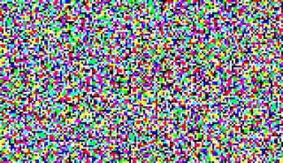
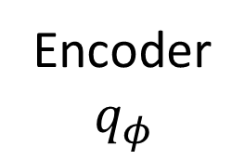
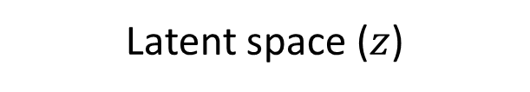
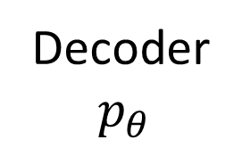
Autoencoders (irregular latent space)
a sample in latent space which is far away from other hidden representation of the training data
Encoder
$$q_{φ }$$
Decoder
$$p_{θ}$$
Data space ($x$)
Latent space ($z$)

Slide 5
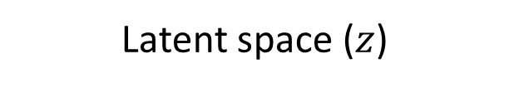
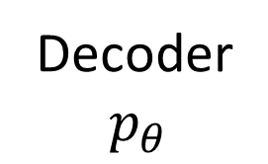
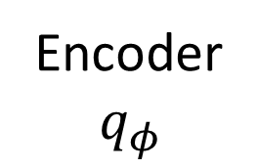
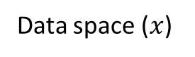
Autoencoders (irregular latent space)
if we select a sample randomly from close neighborhood of the hidden representation of a sample data
Encoder
$$q_{φ }$$
Decoder
$$p_{θ}$$
The closer the random sample is to the hidden representation of the sample data, the more meaningful the decoded image becomes, and the closer it is to the corresponding image in the input data. We can model this with a Gaussian distribution.
Data space ($x$)
Latent space ($z$)

Slide 6
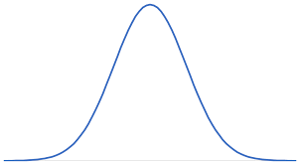
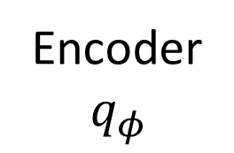
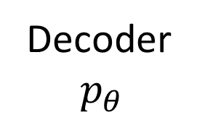
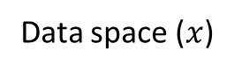
Autoencoders (irregular latent space)
Encoder
$$q_{φ }$$
Decoder
$$p_{θ}$$
Data space ($x$)
Latent space ($z$)

Slide 7
Autoencoders (irregular latent space)
It is natural Autoencoder have irregular latent space because we do not enforce latent space to be regularized.
Making latent space regularized has the following benefits:
1- Meaningful latent space
2- We can generate new data we using suitable sampling method.
This leads to a generative model called Variational autoencoder.

Slide 8
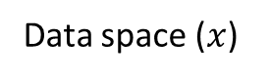
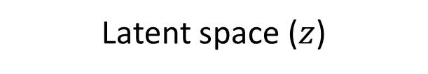
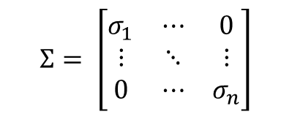
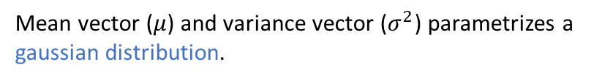
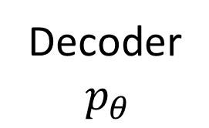
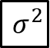
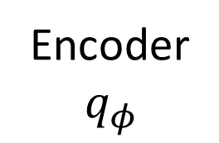
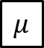
Variational autoencoder
Mean vector ($μ$) and variance vector ($σ^{2}$) parametrizes a gaussian distribution.
$$μ$$
Encoder
$$q_{φ }$$
Decoder
$$p_{θ}$$
$$σ^{2}$$
Data space ($x$)
$$Σ= \left[\begin{matrix}σ_{1} & ⋯ & 0 \\ ⋮ & ⋱ & ⋮ \\ 0 & ⋯ & σ_{n}\end{matrix}\right]$$
Latent space ($z$)
It is assumed that covariance matrix of gaussian distributions are diagonal

Slide 9
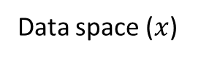
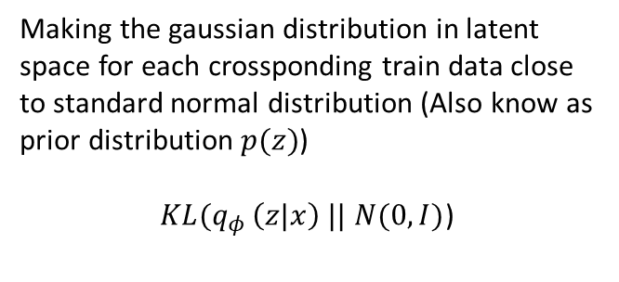
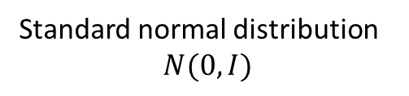
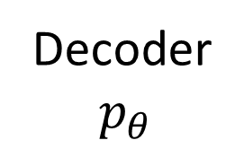
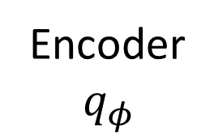
Variational autoencoder (Regularized latent space)
Making the gaussian distribution in latent space for each crossponding train data close to standard normal distribution (Also know as prior distribution $p(z)$)
$KL(q_{φ }\left(z|x\right) ||$ $N(0,I)$)
$$μ$$
Encoder
$$q_{φ }$$
Decoder
$$p_{θ}$$
$$σ^{2}$$
Data space ($x$)
Standard normal distribution
$$N(0,I)$$
Latent space ($z$)

Slide 10
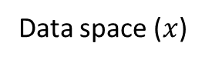
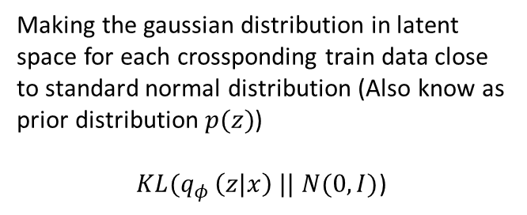
Variational autoencoder (Regularized latent space)
Making the gaussian distribution in latent space for each crossponding train data close to standard normal distribution (Also know as prior distribution $p(z)$)
$KL(q_{φ }\left(z|x\right) ||$ $N(0,I)$)
$$μ$$
Encoder
$$q_{φ }$$
Decoder
$$p_{θ}$$
By making this enforcement, we make the latent space regularized and meaningful and avoid to be disorganized and separated.
$$σ^{2}$$
Data space ($x$)
Latent space ($z$)
By having regularized latent space, we can easily sample from standard normal distribution passing it to decoder to generate meaningful Images.

Slide 11
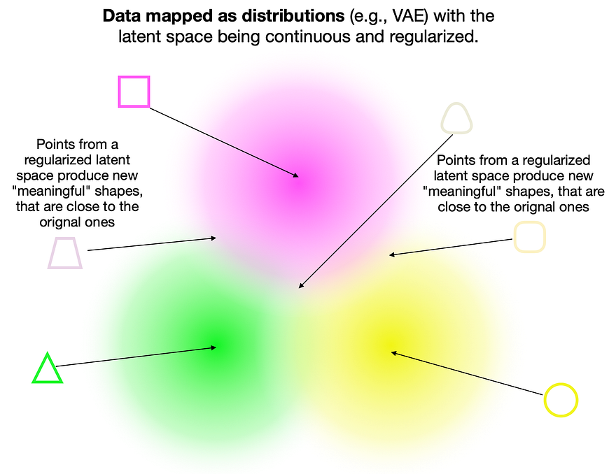
Variational autoencoder (Meaningful latent space)
Image is taken from https://towardsdatascience.com/vae-variational-autoencoders-how-to-employ-neural-networks-to-generate-new-images-bdeb216ed2c0

Slide 12

Variational autoencoder (Latent interpolation)

Slide 13
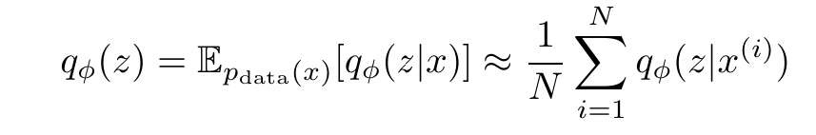
Aggregated posterior distribution
The learned distribution of data in the latent space of VAE is the aggregated posterior distribution.

Slide 14
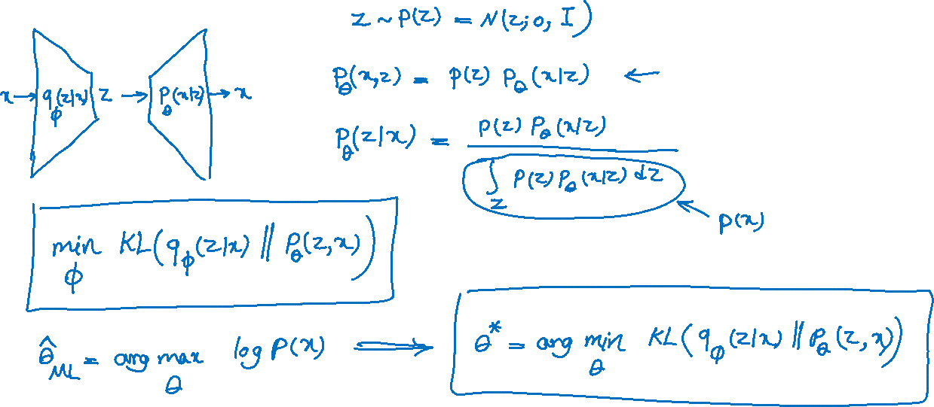

Slide 15
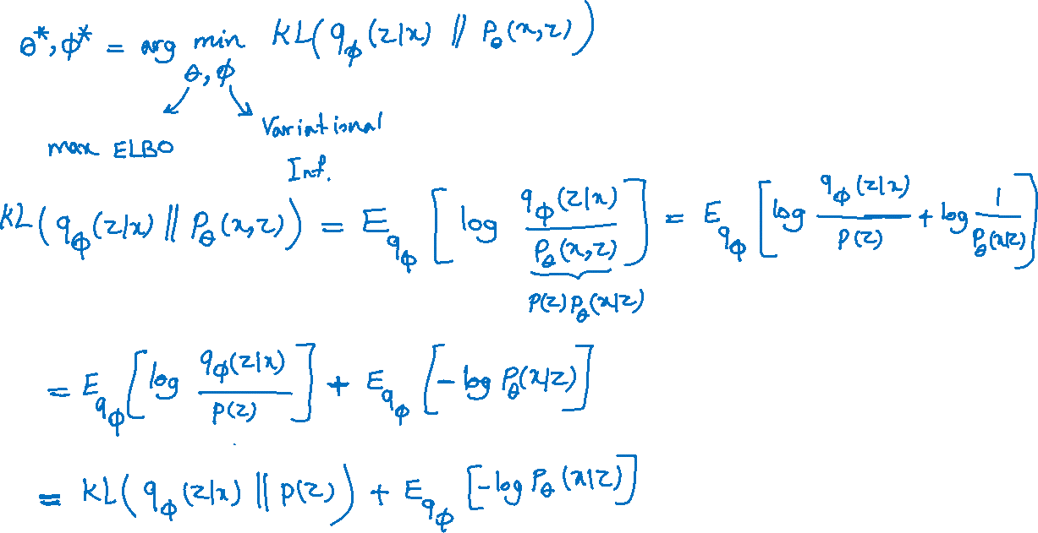

Slide 16
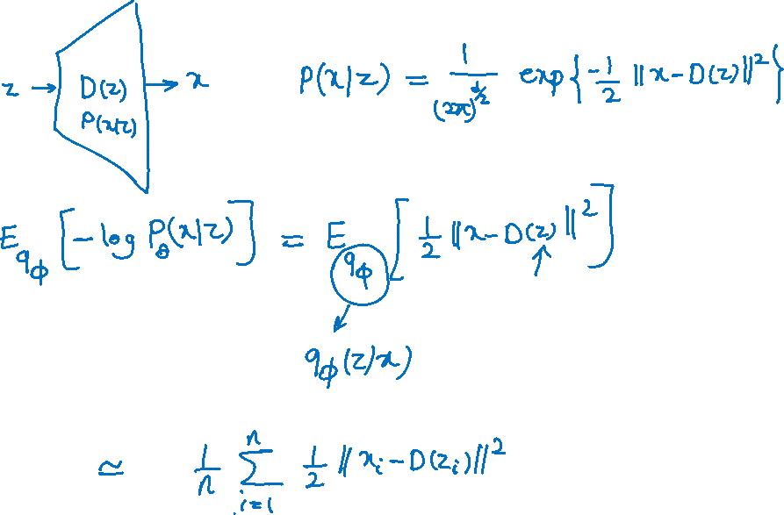

Slide 17
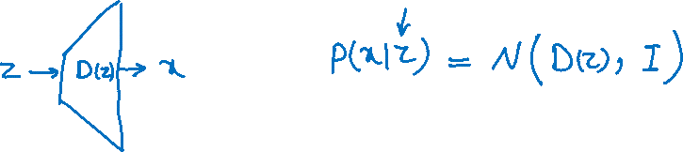

Slide 18
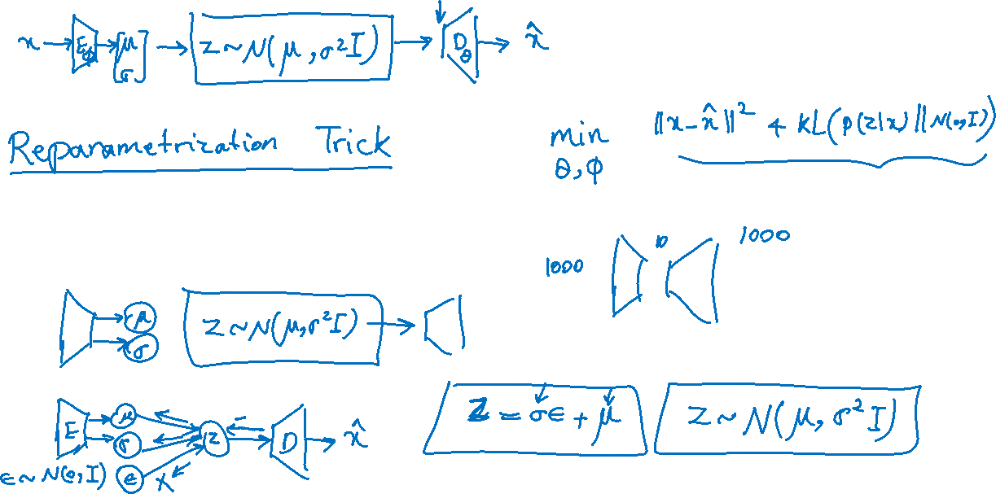

Slide 19
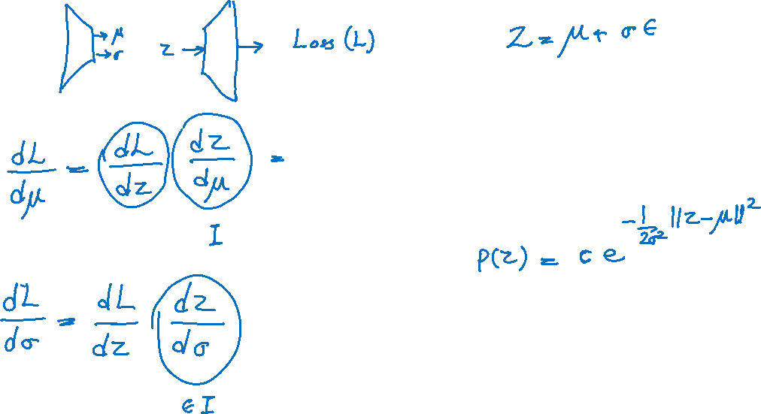

Slide 20
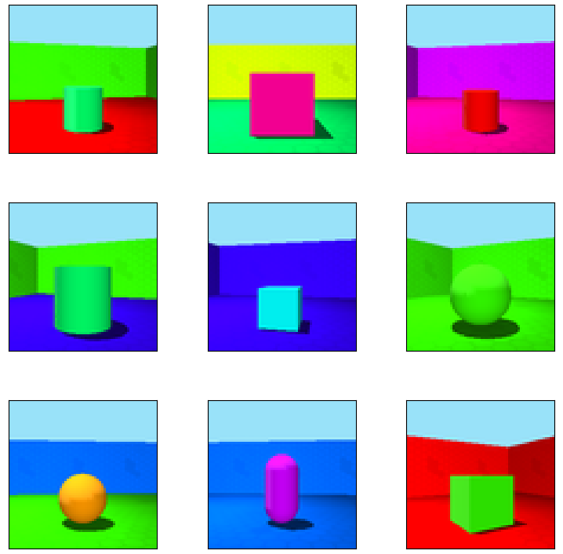
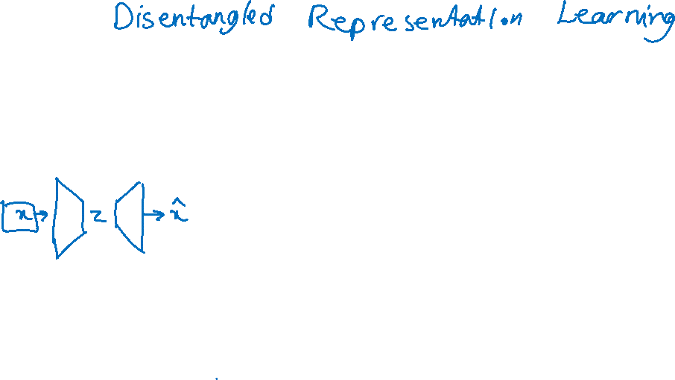
3D shape dataset
3dshapes¹ is a dataset of 3D shapes procedurally generated from 6 ground truth independent latent factors. These factors are:
floor colour
wall colour
object colour
scale
shape
orientation
wall colour
object colour, shape, scale
Floor colour
Image is taken from https://www.tensorflow.org/datasets/catalog/shapes3d
1- Kim, H., & Mnih, A. (2018). ‘Disentangling by Factorising.’ ICML, pp. 2649-2658.
Notes:
Add in sample image to show each feature in in

Slide 21
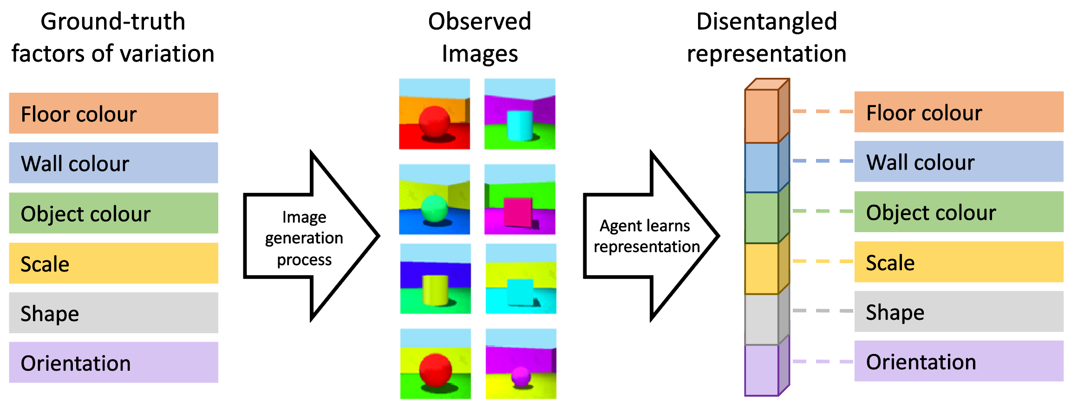
Disentangled representation definition
A disentangled representation is defined as one where single latent units are sensitive to changes in single generative factors, while being relatively invariant to changes in other factors¹.
Image is taken from https://agents.inf.ed.ac.uk/blog/disentangled-representations-rl/
1- Bengio, Y., et al. (2013). ‘Representation learning: A review and new perspectives.’ IEEE Trans. on PAMI, 35(8)
Notes:
It must add that the one-to-one correspondence between generative factor
The equivariance between generative factor and
(Bengio et al., 2013).

Slide 22
DRL¹ helps other ML areas
Generalization & Robustness
Ignoring irrelevant features
Explainability
Each feature has semantic meaning
Fairness
Reducing the effect of the biased (like gender) feature
Controllable data generation
Image generation based on changing semantic features
1- Disentangled representation learning
Notes:
Give an example about Generalization and Robustness in shape 3d dataset about classification of shape

Slide 23
DRL is challenging!
Fully unsupervised complete disentanglement has been proved to be impossible¹.
Real world Images are much more complex and have a sophisticated causal structure between their generative factors.
1- Locatello, F., et al. (2019). ‘Challenging Common Assumptions in the Unsupervised Learning of Disentangled Representations.’ ICML, pp. 4114-4124

Slide 24
VAE based Disentangled representation learning

Slide 25
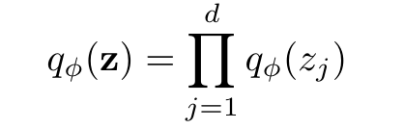
Factorized aggregated posterior distribution
Factorized aggregated posterior distribution plays a key role for learning disentangled representation in VAE based approaches.
It implies that each dimension of the latent space captures a distinct and independent factor of variation in the data.

Slide 26
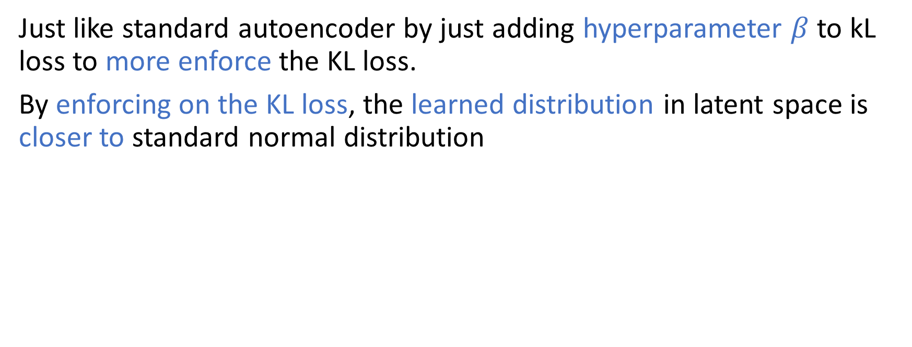
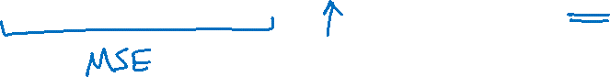
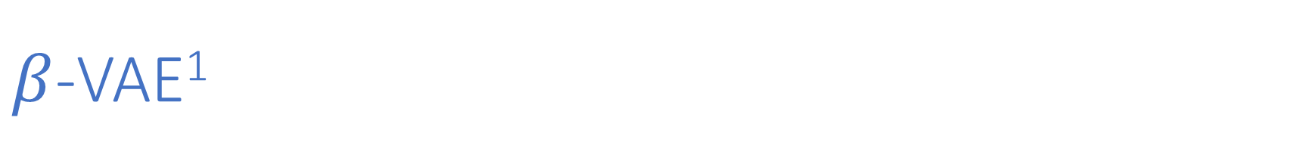
$β$-VAE¹
Just like standard autoencoder by just adding hyperparameter $β$ to kL loss to more enforce the KL loss.
By enforcing on the KL loss, the learned distribution in latent space is closer to standard normal distribution
1- Higgins, I., et al. "beta-vae: Learning basic visual concepts with a constrained variational framework." International Conference on Learning Representations. 2016.

Slide 27


$β$-VAE
The more closer the learned distribution to standard normal distribution the more independent the latent dim
The more independent latent dim, It can capture independent factor of variations of the data
There is trade off between reconstruction loss and KL loss.
A Suitable $β$ is the key to having good disentanglement as well as good reconstruction quality.

Slide 28



$β$-VAE

Slide 29

FactorVAE¹
FactorVAE is an advancement to $β$-VAE aiming to achieve better disentanglement without compromising reconstruction quality.
FactorVAE employs a VAE framework augmented with a penalty encouraging the distribution of representations to be factorial and independent across dimensions.
This approach is shown to improve upon β-VAE by offering a more favorable trade-off between disentanglement and reconstruction quality
1- Kim, H., & Mnih, A. (2018). ‘Disentangling by Factorising.’ ICML, pp. 2649-2658.

Slide 30


FactorVAE (loss)
VAE loss
Total correlation (TC)

Slide 31


Slide 32



FactorVAE vs $β$-VAE
$β$-VAE
FactorVAE

Slide 33


FactorVAE vs $β$-VAE

